Slide 1


SEC285
FUNDAMENTALS OF INFORMATION SYSTEMS SECURITY
Final Project
Jason Banister

Slide 2
Introduction
This course project is a collection of all previous projects performed in virtual environments throughout the course. The compilation illustrates the configuration and testing process in the Microsoft Hyper-V environment, which includes encryption, stateful firewall, multiple-factor authentication, and vulnerability assessment.

Slide 3
Asymmetric Key Encryption

Slide 4
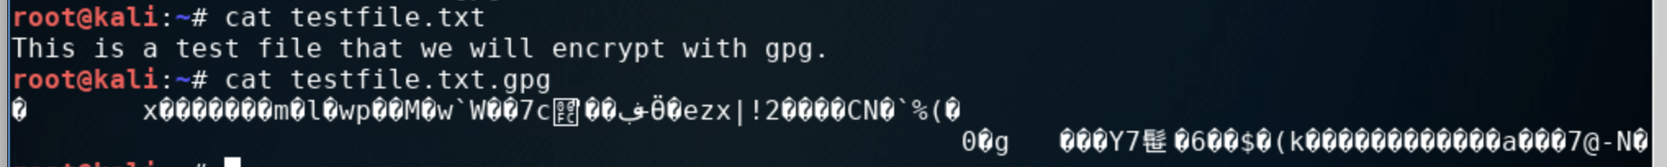
File Encryption
This screenshot shows the following.
Content of the plaintext file
Content of the encrypted file

Slide 5
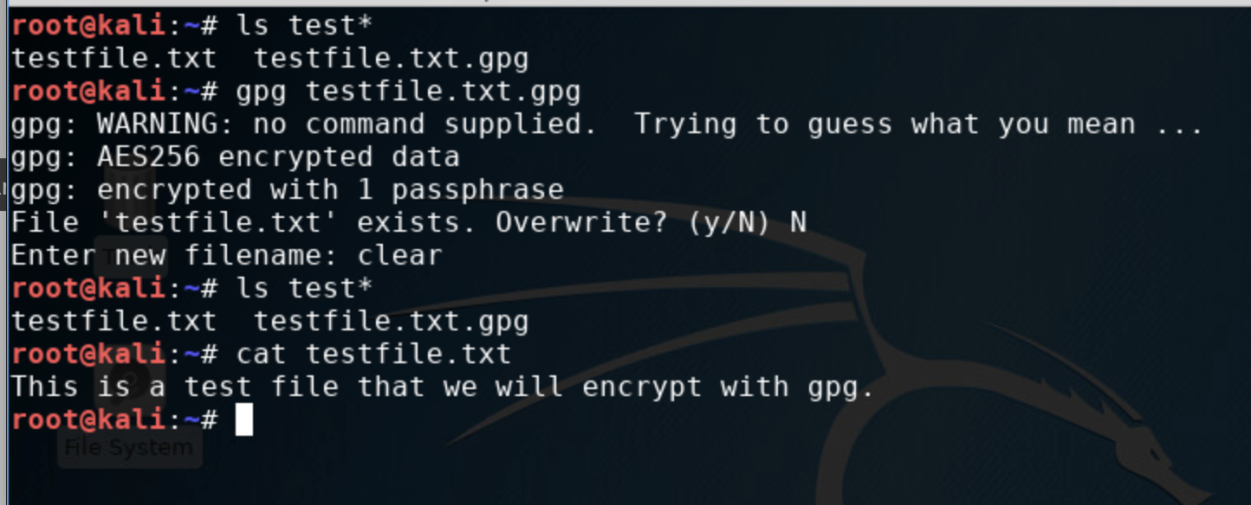
File Decryption
This screenshot shows the following.
The encrypted file listed by itself
The decrypting process
Both the encrypted file and the original plaintext file are listed

Slide 6
Stateful Firewall

Slide 7
Question
What effect does the sudo iptables --policy INPUT DROP command have on the access to computing resources?
Answer here:
The command sudo iptables—-policy INPUT DROP sets the firewall's default behavior to block all incoming connections that do not meet specific criteria.
References:
Professors P. Shaffer, B.M. Piper, E. Aghadiuno Module 3 Presentations
Brainly.com

Slide 8
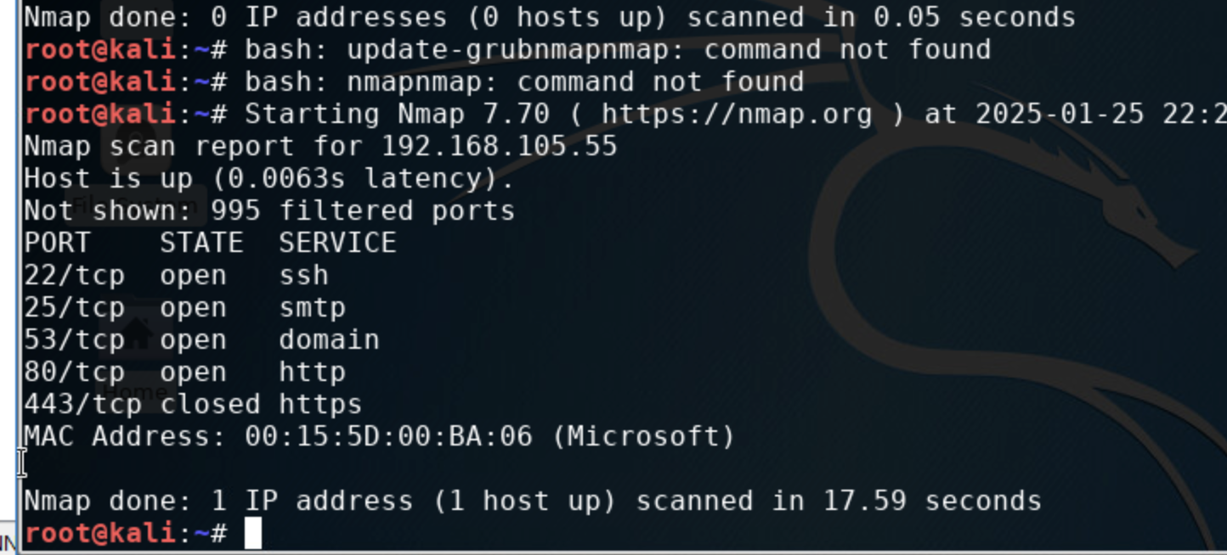
Nmap Scan
This screenshot shows the Nmap scan result of the Linux Server VM.

Slide 9
Bring Your Own Device (BYOD)
Security Policy

Slide 10
Overview:
Tablets, smartphones and laptops have become integral tools in modern enterprise. Social media has become a way to contact and communicate with clients. Smartphones make company representatives available to clients. Laptops enable the transfer of data and media from remote locations. Although they have become important business tools, these devices also allow technical attacks to endanger confidential data.
2. Purpose:
The purpose of this policy is to to establish clear guidelines and procedures for employees using their personal devices (like smartphones, laptops, or tablets) for work-related activities, while ensuring the security of company data, network infrastructure, and compliance with relevant regulations. ABC Corporation also wishes to identify devices that introduce unnecessary vulnerabilities to the organization's computing resources. Timely discovery of potential issues and vulnerabilities can help eliminate or mitigate loss of confidential data and protect the company against “hacking” attacks.
ABC Corporation also wishes to balance the benefits of employee flexibility and cost savings with the need to protect sensitive corporate information and maintain network security, define acceptable use of personal devices for work, establish clear responsibilities and procedures for device management, data protection and incident response in case of device loss, theft, or compromises.

Slide 11
3. Scope:
The scope of this BYOD policy only includes employee-owned iOS and Android smartphones and tablets and is focused on the “work” segment of the personal mobile device. The company will limit the scope of its management and security of the employee’s personal mobile device to those threats that create a legal and compliance issue on the “work segment” portion of the device.
4. Policy:
The following are the minimum requirements for a device to be considered compliant:
The device must be running Operating System X.
The device must have the latest available patches for Operating System X installed.
The device must have an up-to-date antivirus software installed.
The device must have a firewall in place.

Slide 12
Noncompliance and Remediation
If a device does not meet these requirements, it is considered noncompliant and will not be granted access to ABC Corporation's network. Noncompliant devices are required to undergo a remediation process to address the areas of noncompliance.
The responsibility for remediation falls on the device owner. They must take the necessary steps to bring their device into compliance, such as updating their operating system, installing the necessary patches, or setting up a firewall.
Once the remediation process is complete, the device will be reassessed for compliance. If it meets all the requirements, it will be granted access to the network.

Slide 13
5. Policy Compliance:
The ABC Corporation team will verify compliance with this policy through various methods, including but not limited to periodic walk-throughs, video monitoring, intrusion detection tools, business tool reports, internal and external audits, and feedback to the policy owner.
An employee found to have violated this policy may be subject to disciplinary actions up to and including termination of employment.
First violation of this policy will result in the employee receiving a warning from their manager that they are in violation of policy as well as an official warning being placed in the employee’s personnel file.
A second violation will result in the revocation of access to privileged company resources, which may or may not include the Internet or email.
Third violation will result in the employee being suspended without pay for one week without pay.
Fourth violation will result in termination of employment.
6. Related Standards, Policies, and Processes:
This policy abides by the standards of any applicable CPA, HIPAA, and other PII policies.

Slide 14
7. Definitions and Terms:
BYOD—Bring Your Own Device
Mobile devices—A mobile device is a small, portable computer that can be carried by a person and used to store, process, and transmit information. Types of mobile devices include Smartphones, Tablets, Laptop computers, Smartwatches, E-readers, and handheld gaming consoles.
CIA—Confidentiality, Integrity, and Availability.
PII—Personally Identifiable Information
8. Revision History:
Date of change | Responsible | Summary of change
February 2025 | ABC policy team | Updated and converted to new format

Slide 15
Multifactor Authentication (MFA)

Slide 16
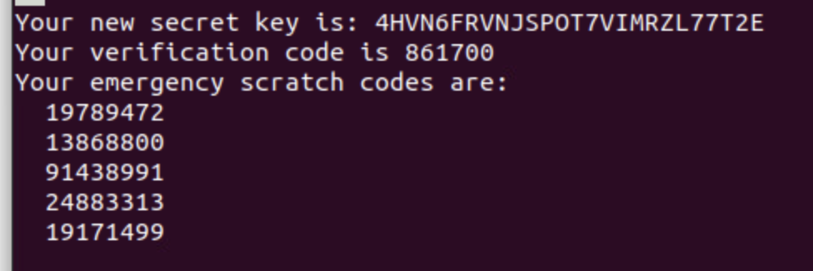
Common-auth Configuration File
This screenshot shows the entry that indicates the use of the Google Authenticator module.

Slide 17
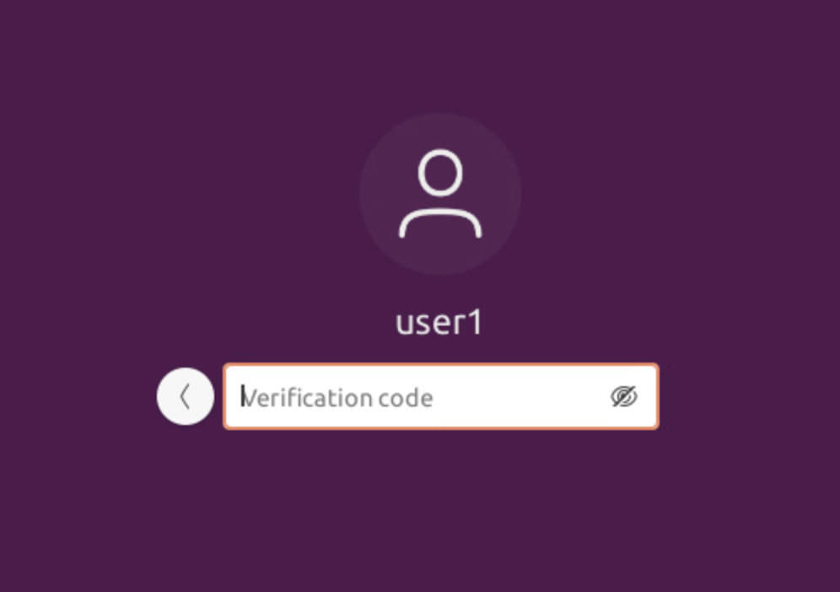
MFA Logon Screen
This screenshot shows the logon screen where a verification code is required.

Slide 18
Vulnerability Assessment

Slide 19
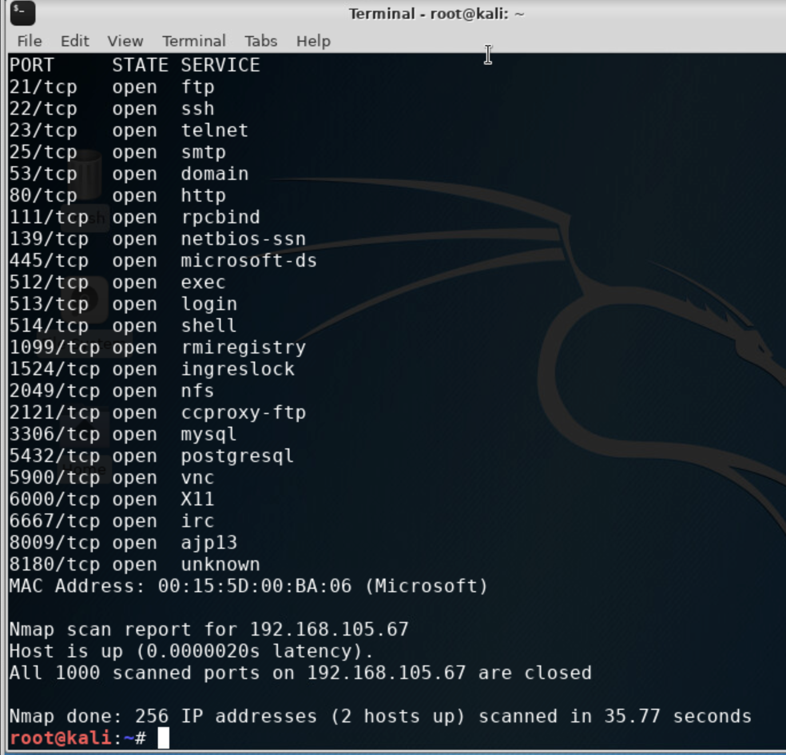
Nmap
This screenshot includes the scan result showing both the Kali and Linux Server VMs.

Slide 20
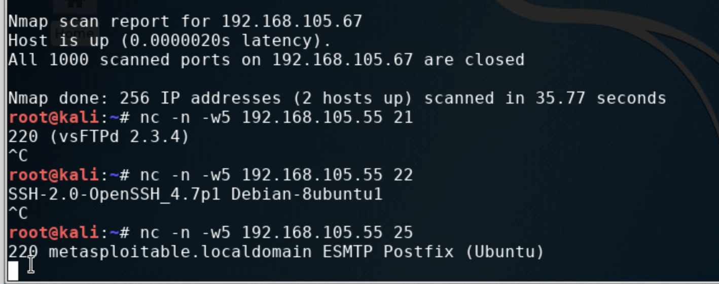
NetCat
This screenshot includes the scan result showing both the Kali and Linux Server VMs.

Slide 21
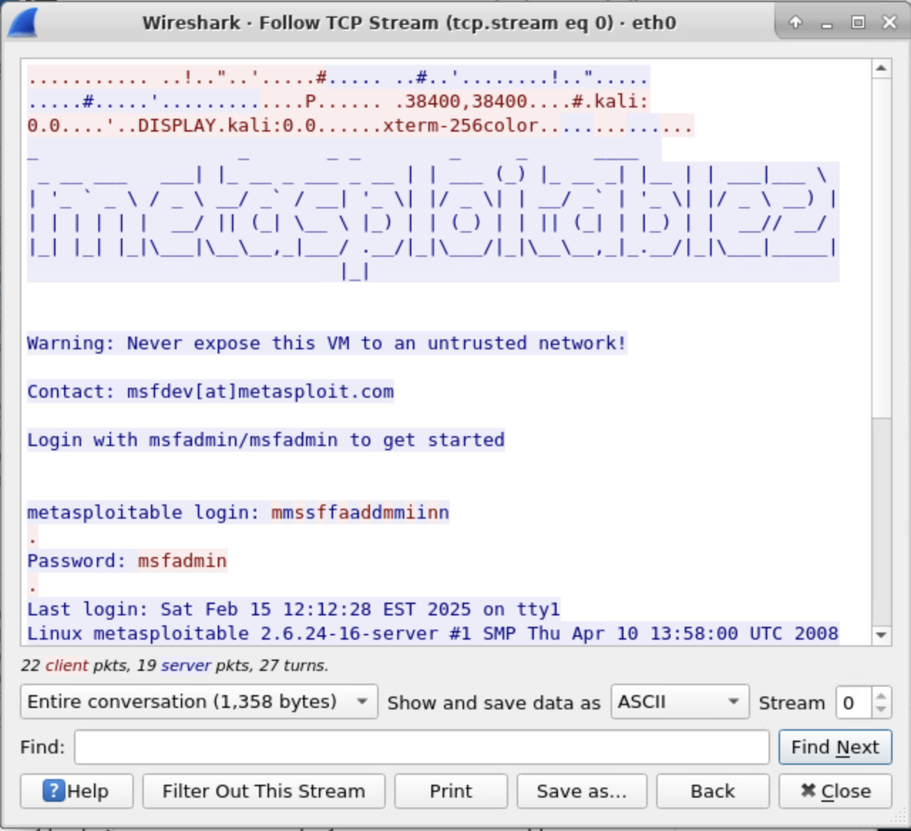
Wireshark
This screenshot includes the Wireshark—Follow TCP Steam window showing the Telnet username and password.

Slide 22
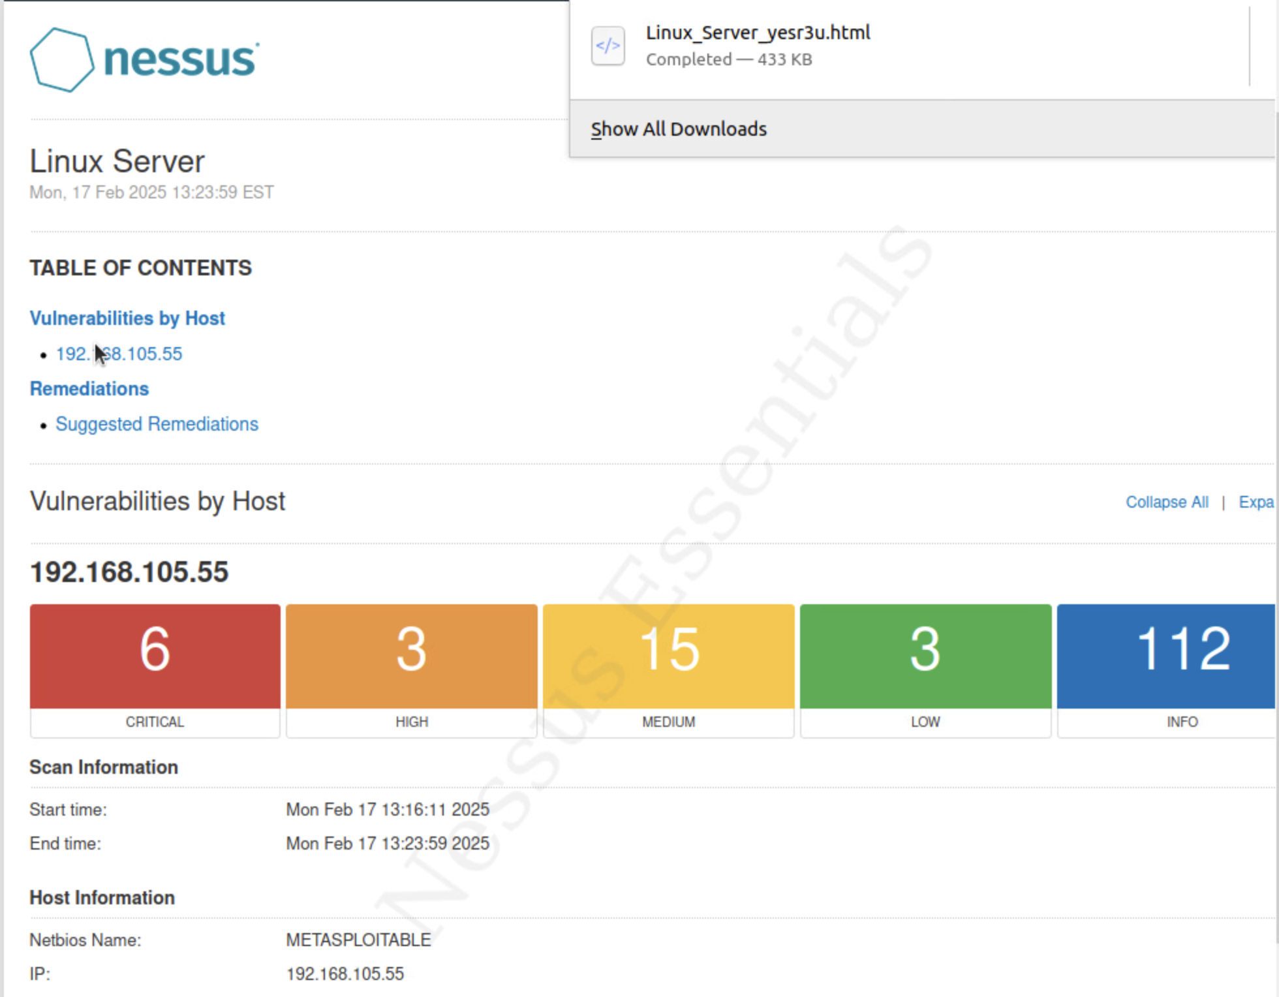
Nessus
This screenshot includes the high-level view of the Nessus vulnerability scan report (showing categories of vulnerability in different colors).

Slide 23
PROJECT CHALLENGES

Slide 24
Challenges encountered during the project process were primarily centered on creating a Bring Your Own Device (BYOD) Policy. First, designing a (BYOD) Policy was an issue because I personally do not approve of employees bringing personal electronic devices to the office. There are obvious risks to the matter. However, a secured network with a strong BYOD Policy in place can clearly mitigate those issues.
Also, while researching BYODs, I felt that some of the policies were too lenient in regard to policy compliance violations. I chose to implement a moderately strict compliance policy.

Slide 25




CAREER SKILLS LEARNED

Slide 26
While taking SEC285, I learned several career skills that will help build the foundation for my future career. The course focused on the configuration and testing process within the Microsoft Hyper-V environment, which included:
encryption
stateful firewall
multiple-factor authentication
vulnerability assessment

Slide 27
CONCLUSION

Slide 28
As previously stated, this course project is a collection of all projects performed in virtual environments throughout this course. This compilation illustrates the configuration and testing process in the Microsoft Hyper-V environment.
While utilizing the virtual machine setting, activities were completed to learn:
Asymmetric key encryption as well as decryption
A stateful firewall and Nmap scan
The creation of a Bring Your Own Device Policy
The design of a Multifactor Authorization for the VM
How to perform vulnerability assessments using Nmap, Netcat, Wireshark, and Nessus

Slide 29
REFERENCES
Professors P. Shaffer, B.M. Piper, E. Aghadiuno Module Presentations
Brainly.com
Weekly Module Project videos
https://cdn2.hubspot.net/hub/445439/file-2042247754-pdf/images/Sample-BYOD-Policy-Template.pdf%3Ft=1468565447264
https://www.dashlane.com/blog/byod-policies-for-organizations

