Slide 1

SEC290
FUNDAMENTALS OF INFRASTRUCTURE SECURITY
FINAL COURSE PROJECT
JASON BANISTER

Slide 2
INTRODUCTION
FUNDAMENTALS OF INFRASTRUCTURE SECURITY
This project is a collection of all previous projects performed in virtual environments throughout the course. The compilation illustrates configuring firewall rules, deploying Snort sensors for network intrusion detection, exploring SSL encryption, analyzing traffic to detect attacks, exploiting Microsoft vulnerabilities, and conducting live memory analysis.

Slide 3
Manual Vulnerability Analysis (on a test VM network)

Slide 4
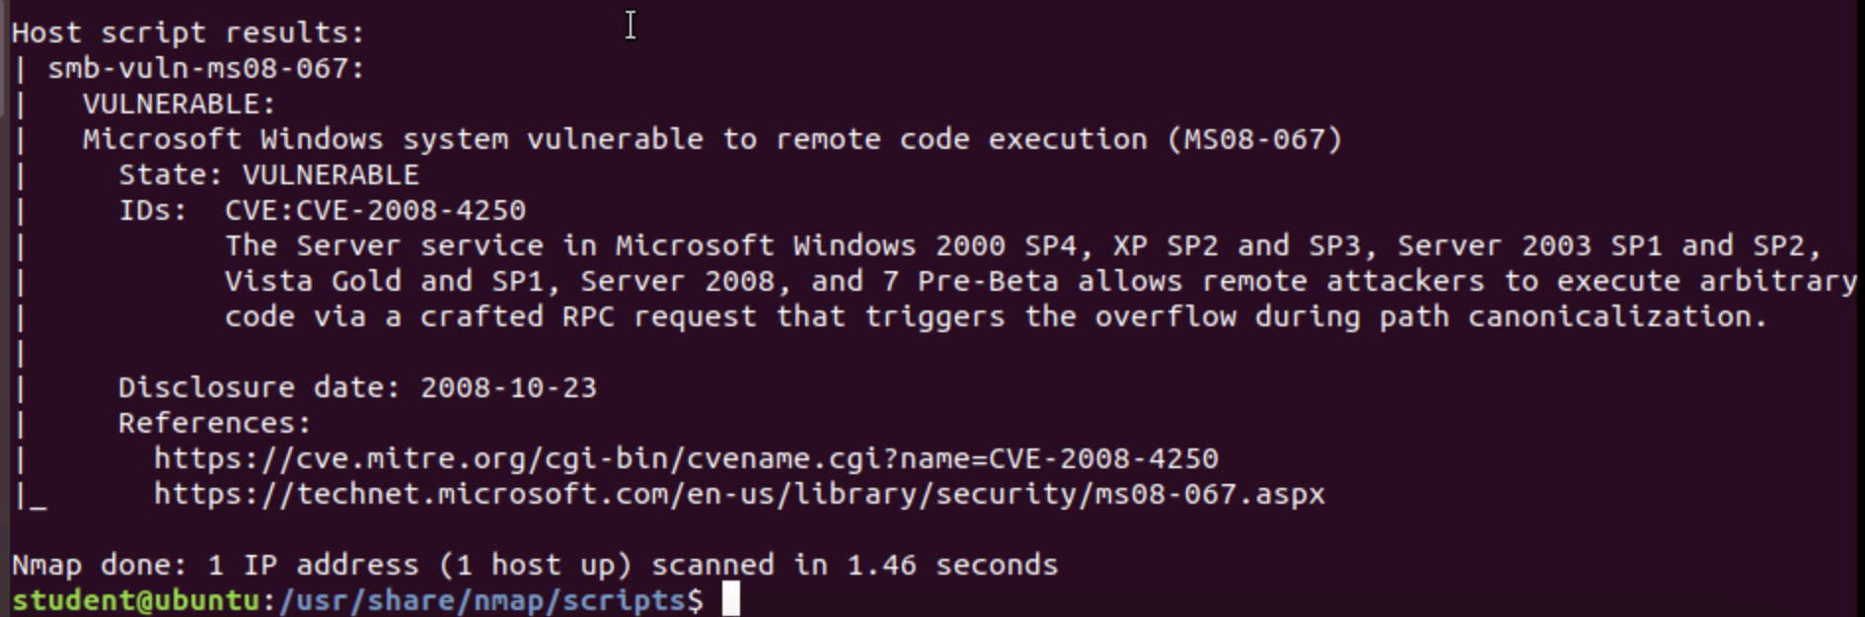
Microsoft Windows Bulletin MS08-067 Vulnerability

Slide 5
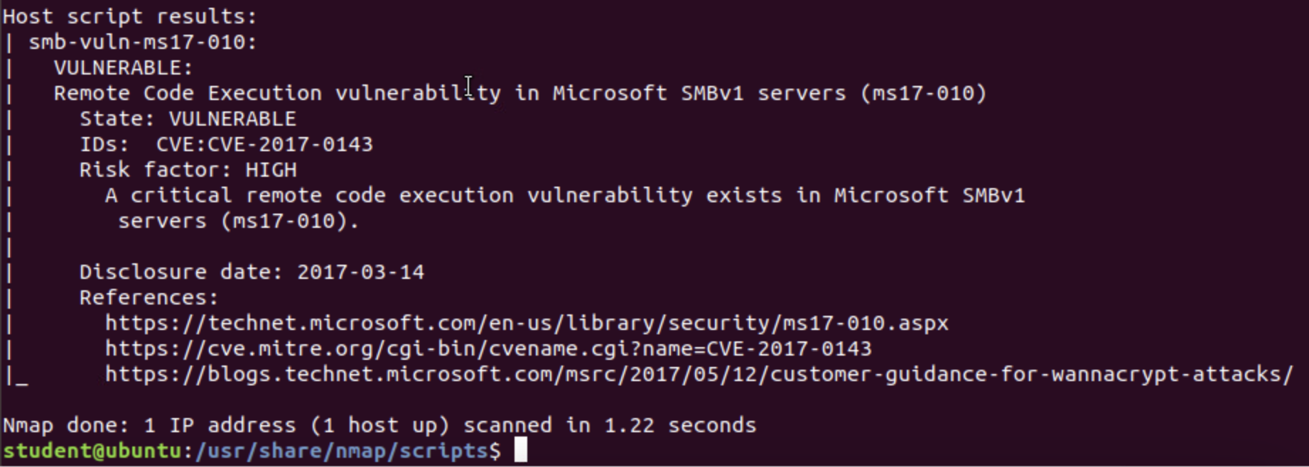
Microsoft Bulletin MS17-010 Vulnerability

Slide 6
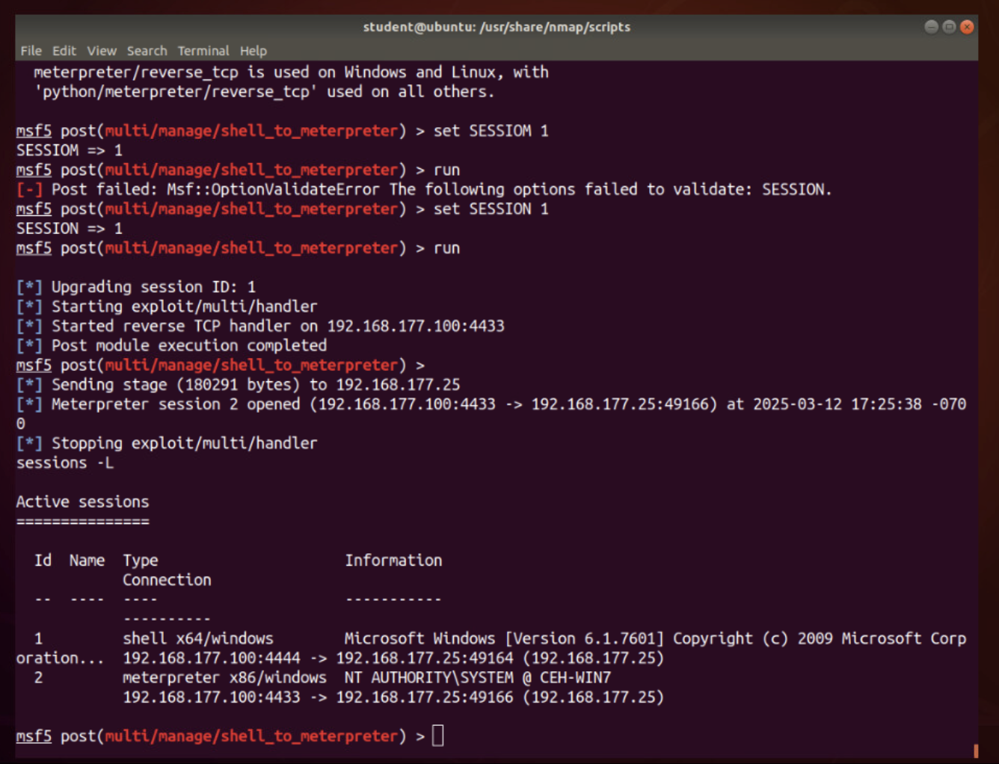
Meterpreter Session Command Output

Slide 7
Intrusion Analysis Using Wireshark

Slide 8
Basic Attack Analysis
Look at captures no. 20 and 22. (You can use the “Go” link at the top of the Wireshark screen to quickly go to a specific capture) Both packets are ICMP traffic but there are subtle differences between them. Compare the time-to-live and data field sizes in the two packets. What differences do you see?
Do a little Internet research to discover which operating systems use the specific values in their ping commands. What operating system generated the echo request in capture 20?
Review packet no. 37 and beyond, what do you think is taking place here?
Look at capture 22846. What is suspicious about the flag settings in this packet?
What is the IP address of the host being targeted?
Packet 20 had a TTL of 64, while packet 22’s was 128. The packet length of 20 was 98 and the packet length of 22 was 74.
The operating system that generated the echo request in capture 20 would be a Linux system, so therefore it was the Ubuntu VM.
At packet 37, protocol traffic switches from ARP to TCP. Flags are set prior to 37. The traffic following 37 begins to show lines in red. This is an indication that reset flags are set or some type of abort has happened. This could be a conversation between a client and an attacker in the network.
A Fin flag is set in 22846. In the prior packet, RST and ACK flags are set. Also, the Win is doubled to 2048 in packet 22846.
The IP address of the targeted host is 192.168.25.1

Slide 9
References
Module 2 Project Video
https://osqa-ask.wireshark.org/questions/25704/finding-an-intruders-operating-system/
www.geeksforgeeks.org

Slide 10
Open SSL

Slide 11
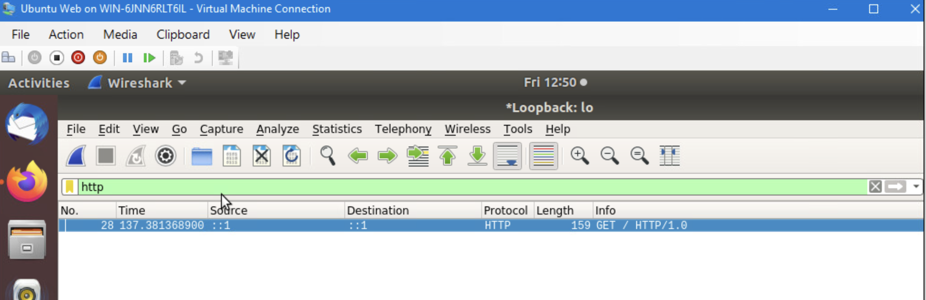
Creating and testing an SSL/TLS file
Take a screenshot of the output in Step 20.
It should show the GET request in the Info column.

Slide 12
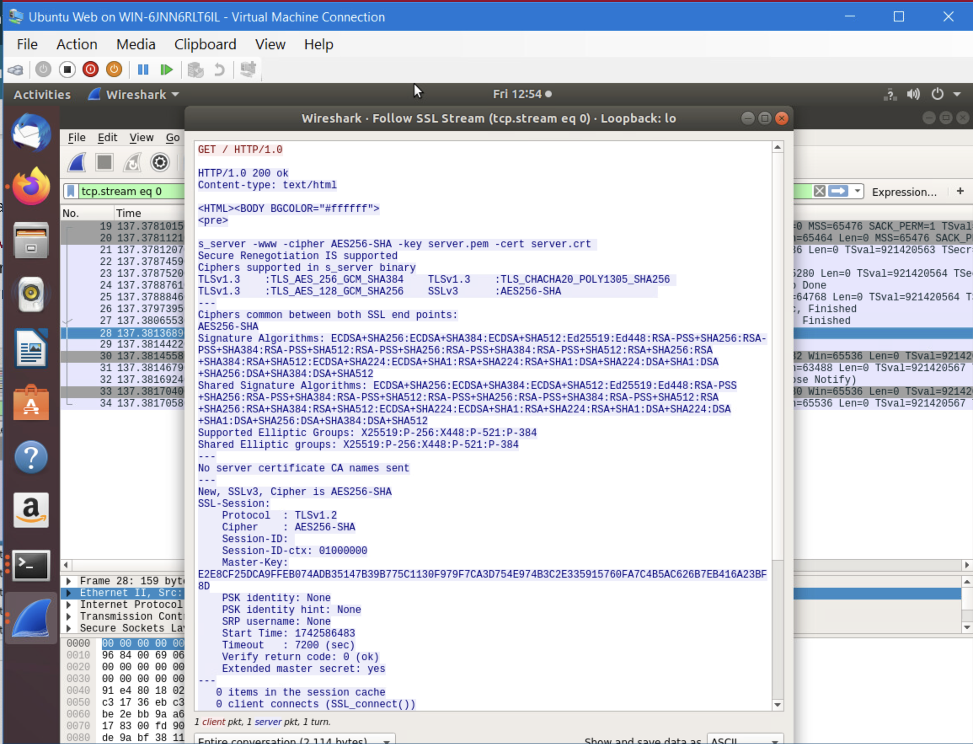
Creating and testing an SSL/TLS file cont’d
Take a screenshot of the output in Step 22.
It should show the decrypted SSL stream.

Slide 13
References
Module 3 Project Video
https://duckduckgo.com/?q=where+is+the+
GET+request+in+a+wireshark+packet+capture%3F+site%3Aosqa-ask.wireshark.org&ia=web
https://superuser.com/

Slide 14
Snort Intrusion Detection and Intrusion Prevention System (IDS/IPS)

Slide 15
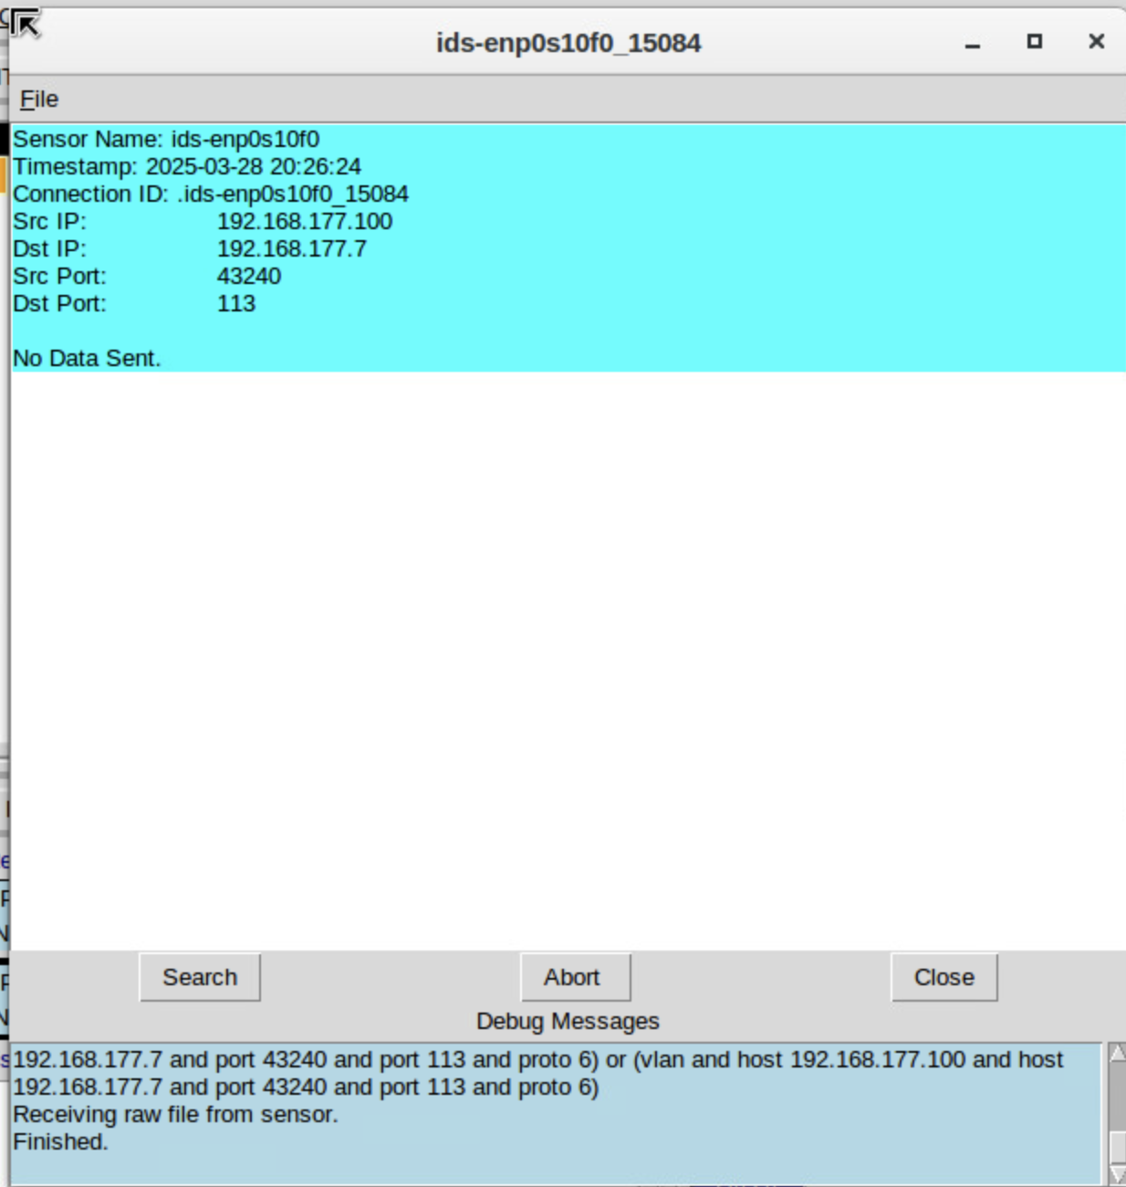
Testing Snort Rules
Take a screenshot of the output in Part 1 Step 17.
It should show the transcript of the XMAS scan alert.

Slide 16
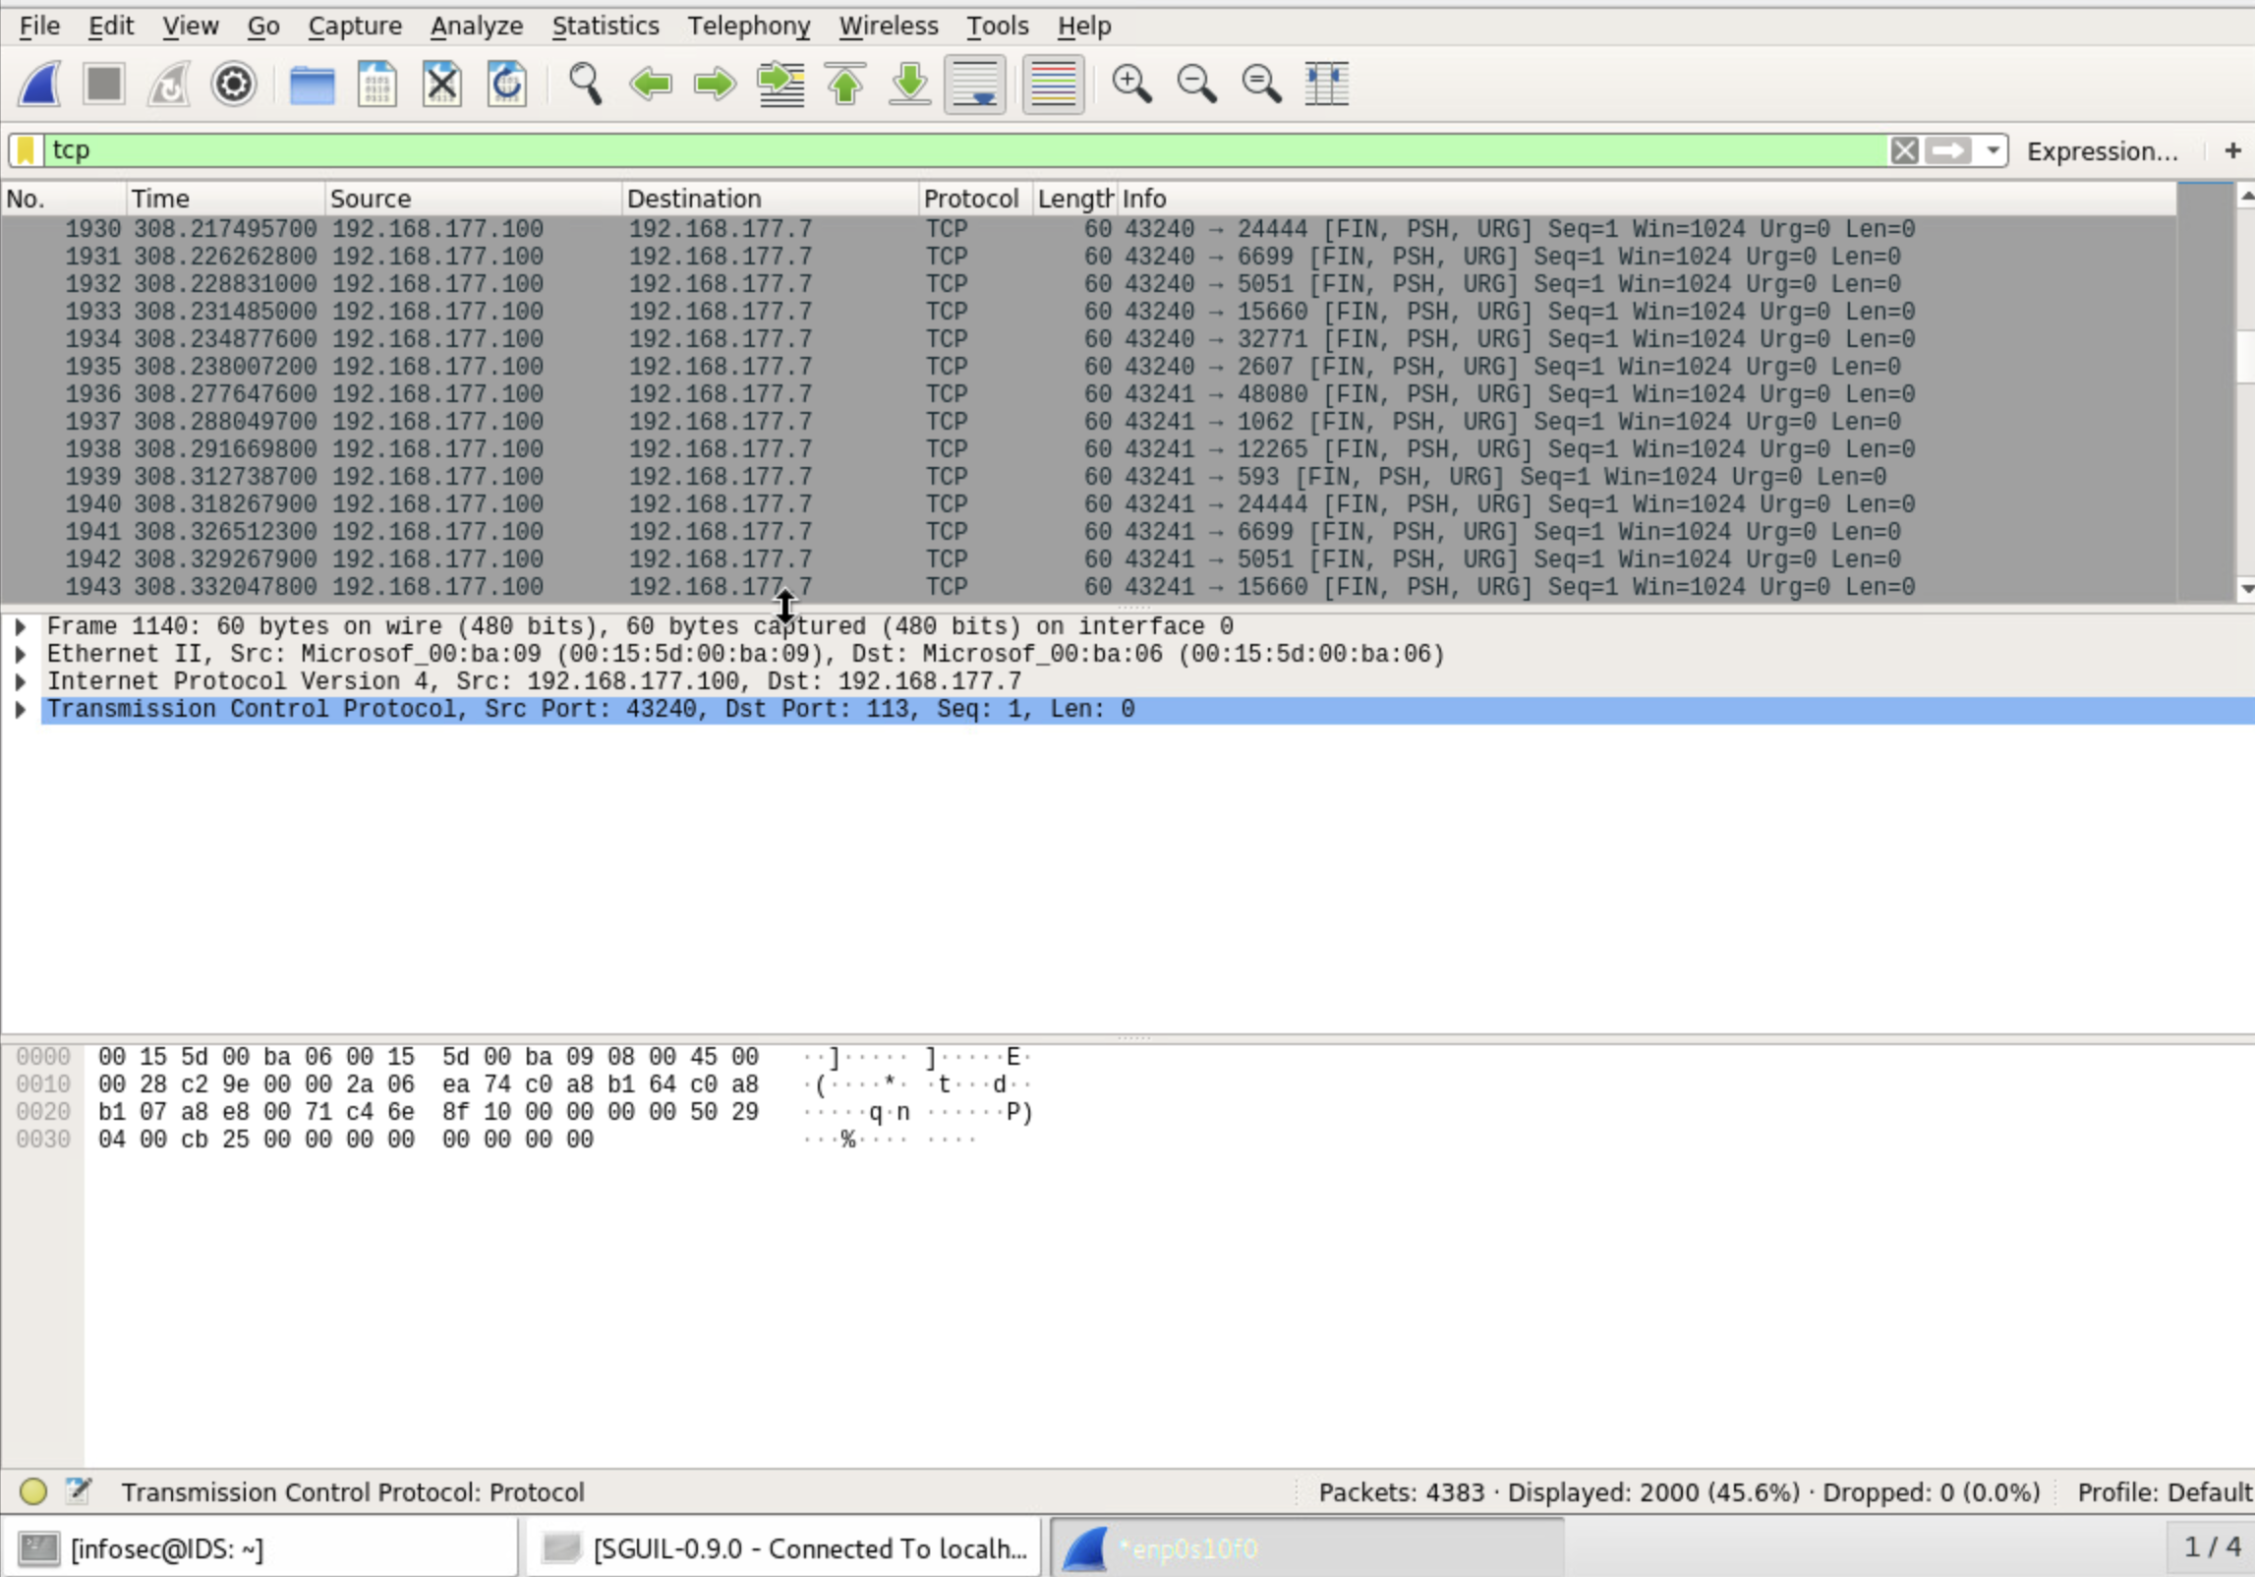
Testing Snort Rules, cont’d
Take a screenshot of the output in Part 1 Step 20.
It should show the TCP packets generated by the XMAS scan.

Slide 17
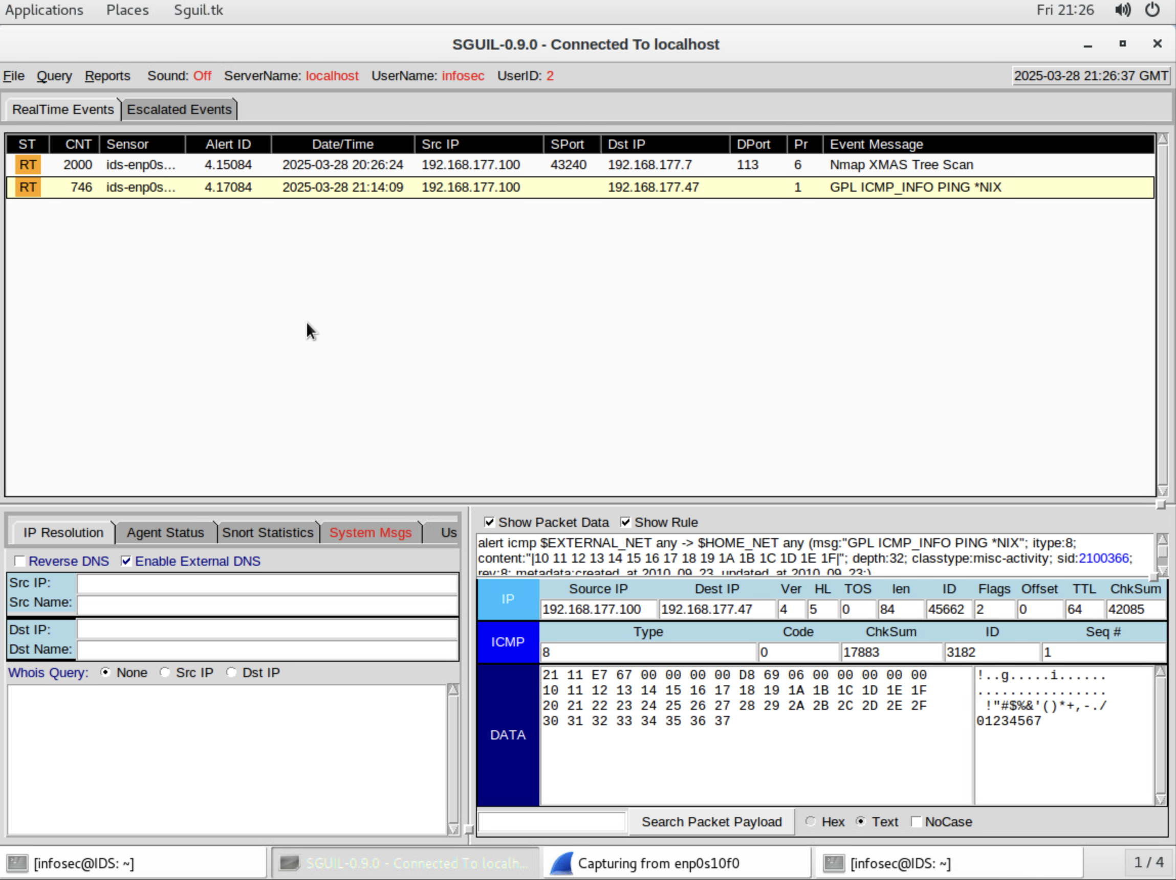
Creating Snort Rules
Take a screenshot of the output in Part 2 Step 7.
It should show the ping activity alert.

Slide 18
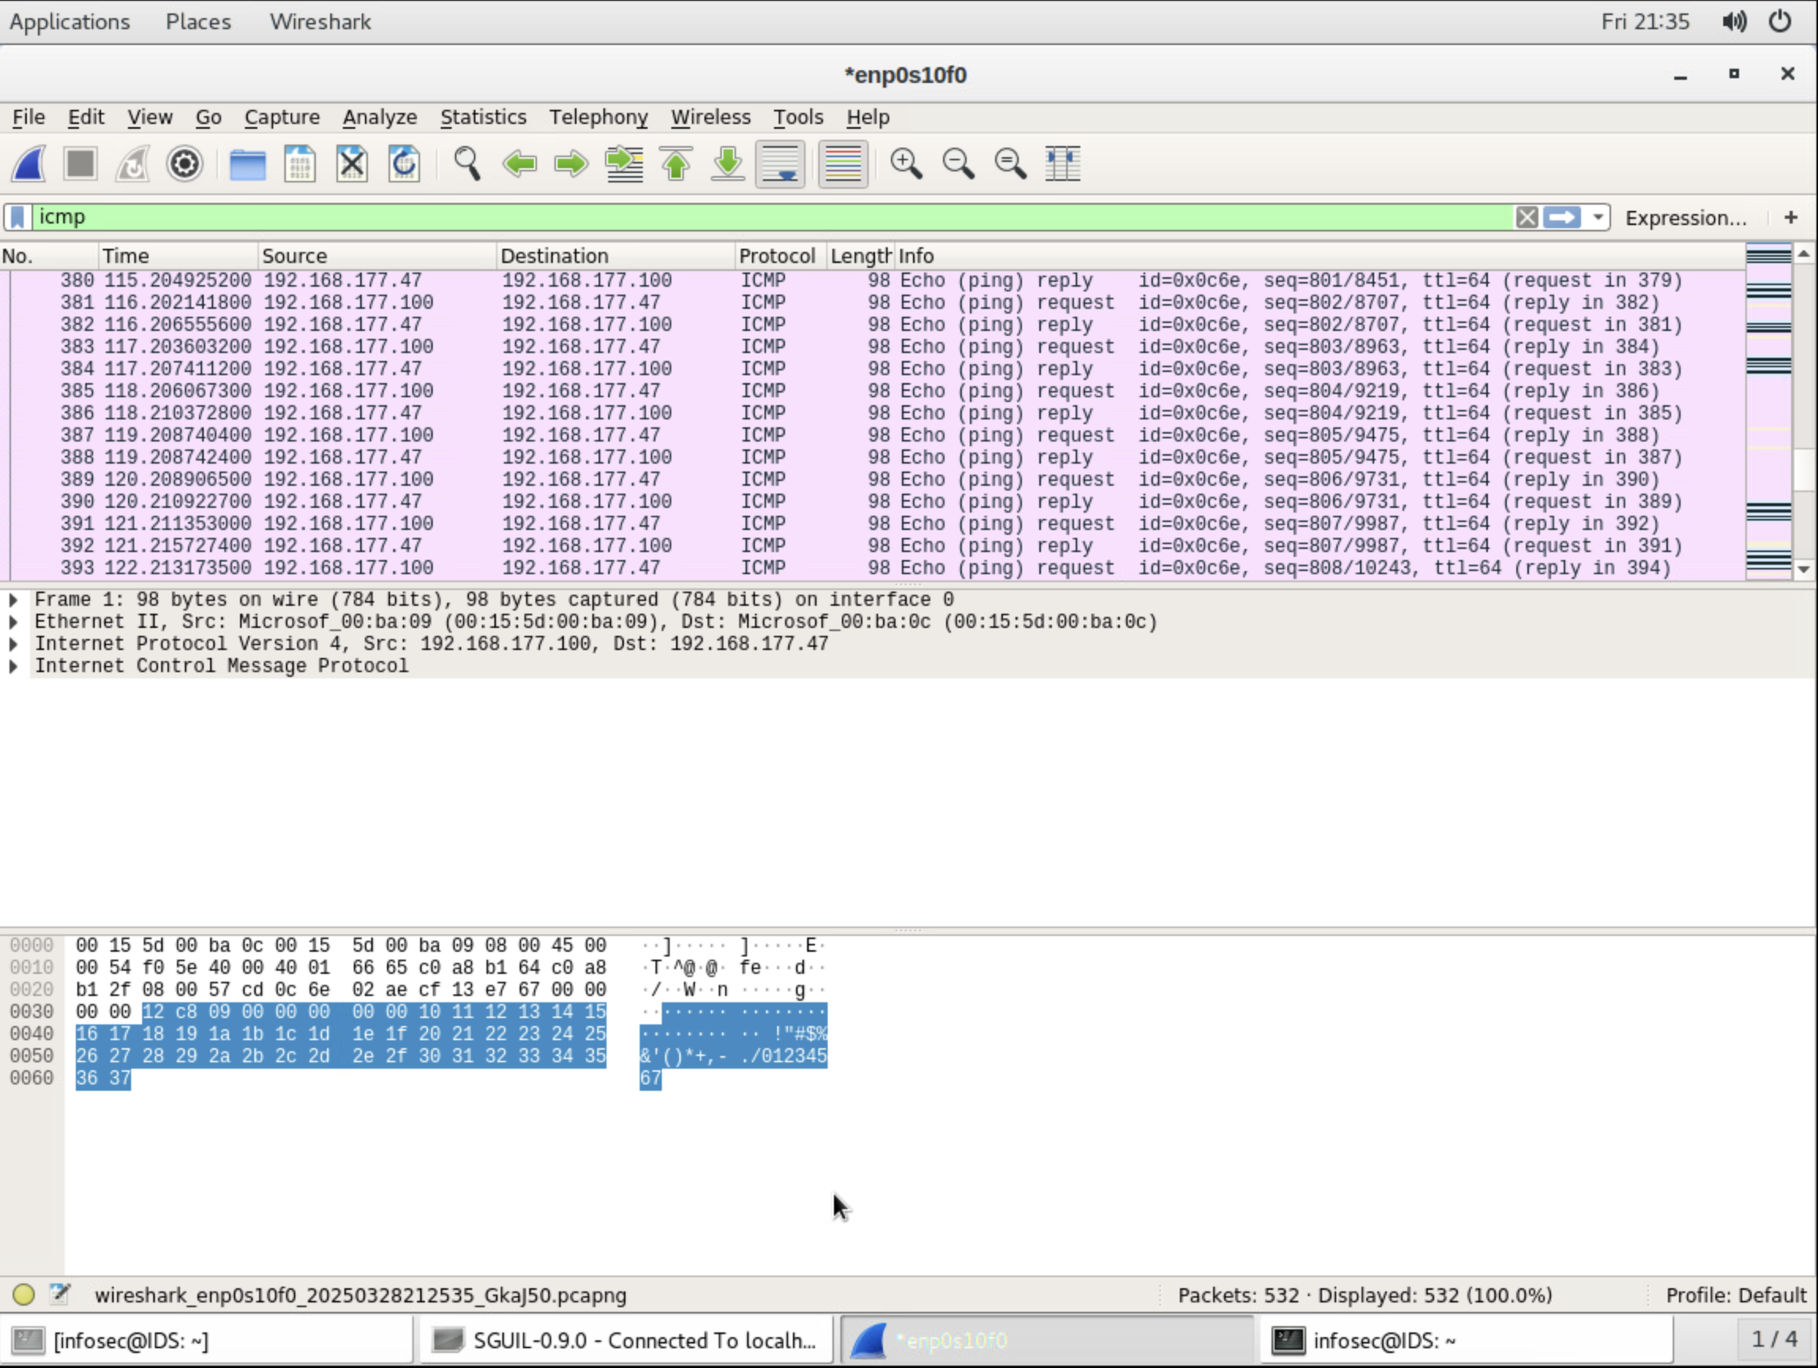
Creating Snort Rules, cont’d
Take a screenshot of the output in Part 2 Step 8.
It should show the ICMP packets generated by the ping activity.

Slide 19
Live Memory Analysis

Slide 20
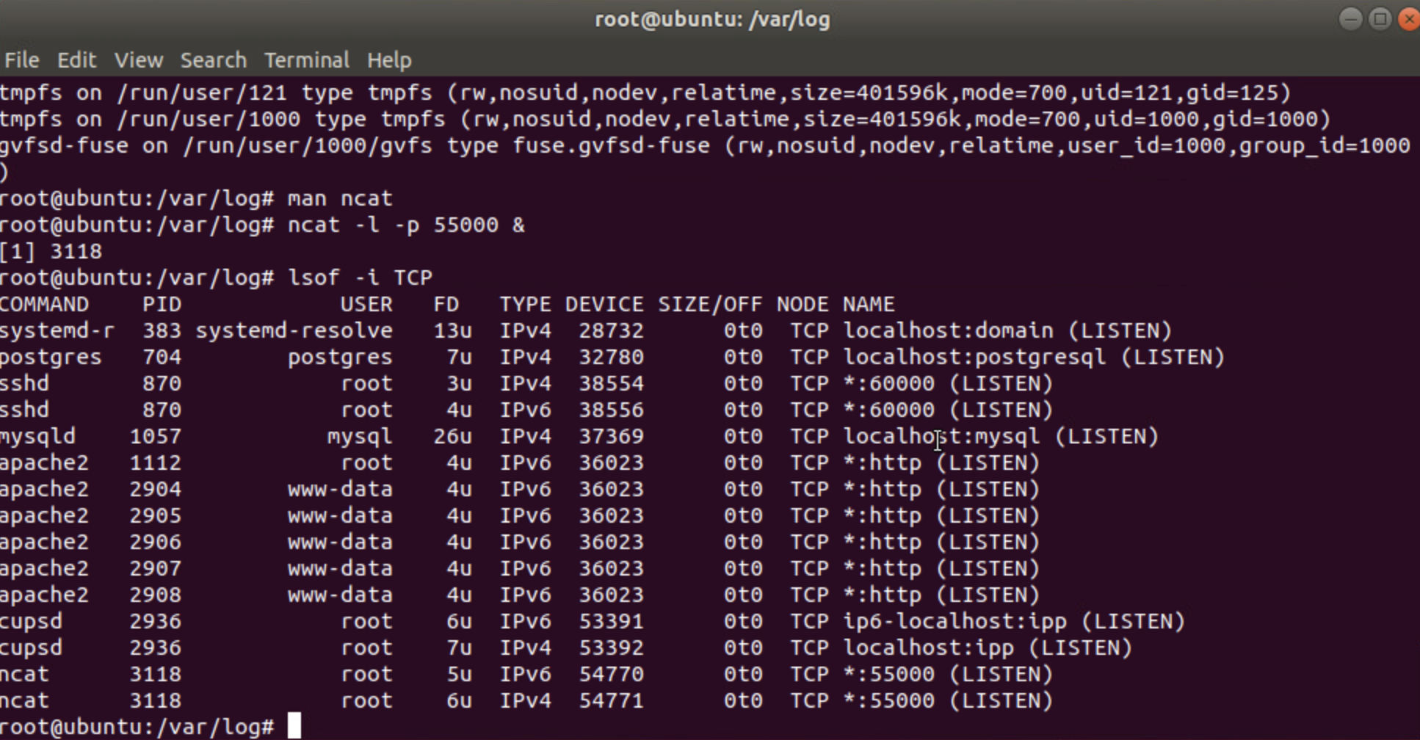
Linux Processes
Take a screenshot of the output in Part 1, Step 16.
It should show port 55000 open for both IPv4 and IPv6.

Slide 21
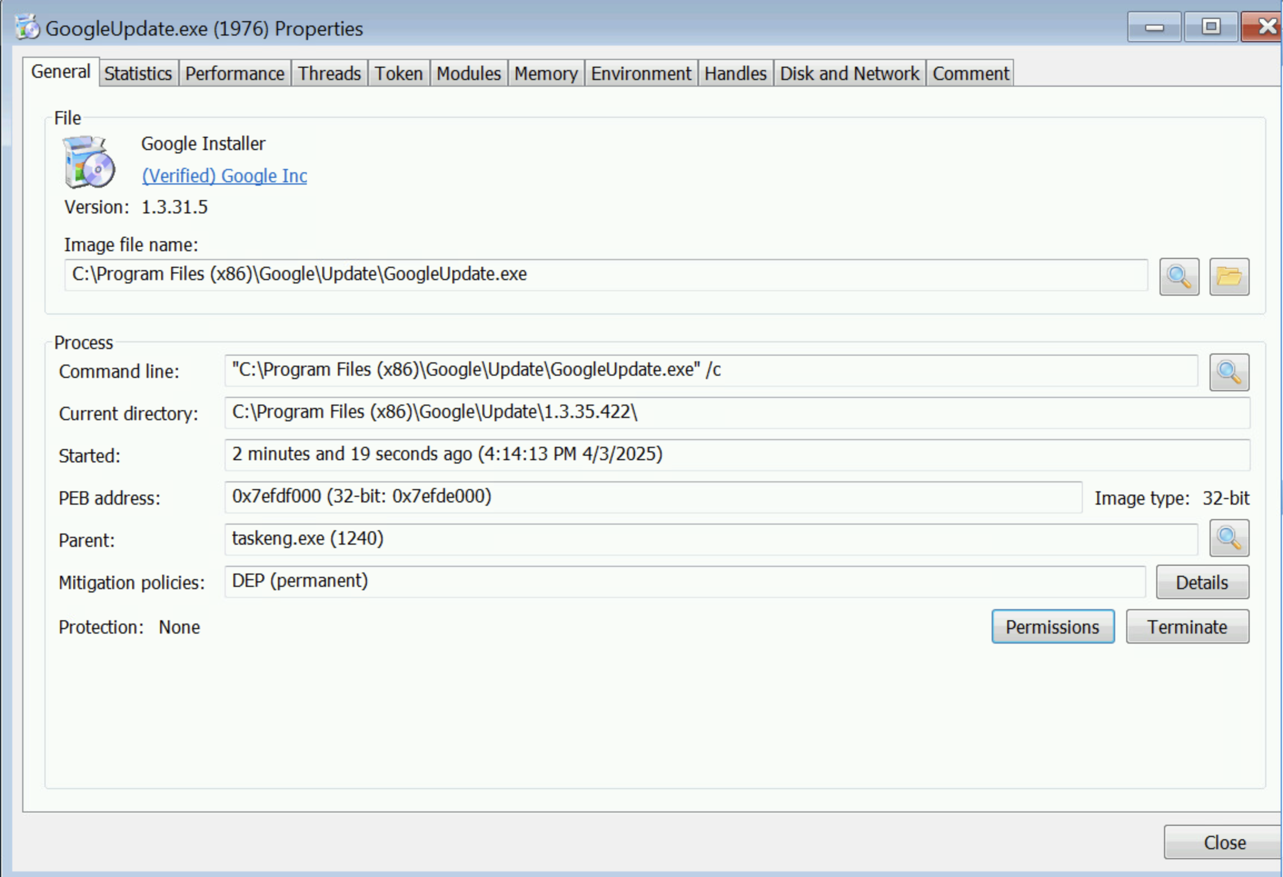
Process Hacker
Take a screenshot of the output in Part 2, Step 5.
It should show properties of a chosen process.

Slide 22
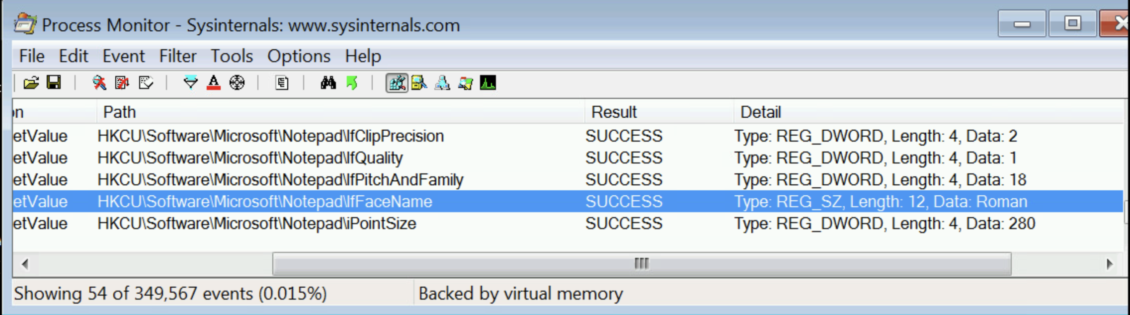
Process Monitor
Take a screenshot of the output in Part 3, Step 13.
It should show ifFaceName in the Path column and Data: Roman in the Detail column.

Slide 23
Module 5 Project Video
https://www.varonis.com/blog/process-hacker
References

Slide 24
Firewall

Slide 25
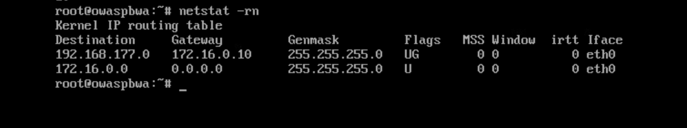
Take a screenshot of the output in Part 1 Step 21.
It should show the output of the DMZ Route Table.
Time-based Access

Slide 26
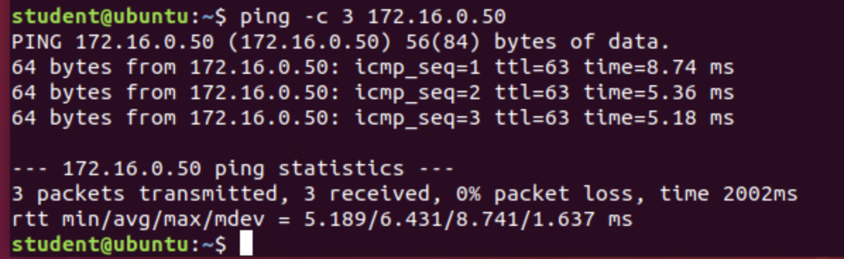
Time-based Access
Take a screenshot of the output in Part 1 Step 26.
It should show a successful ping from the Ubuntu Web VM and the DMZ VM.

Slide 27
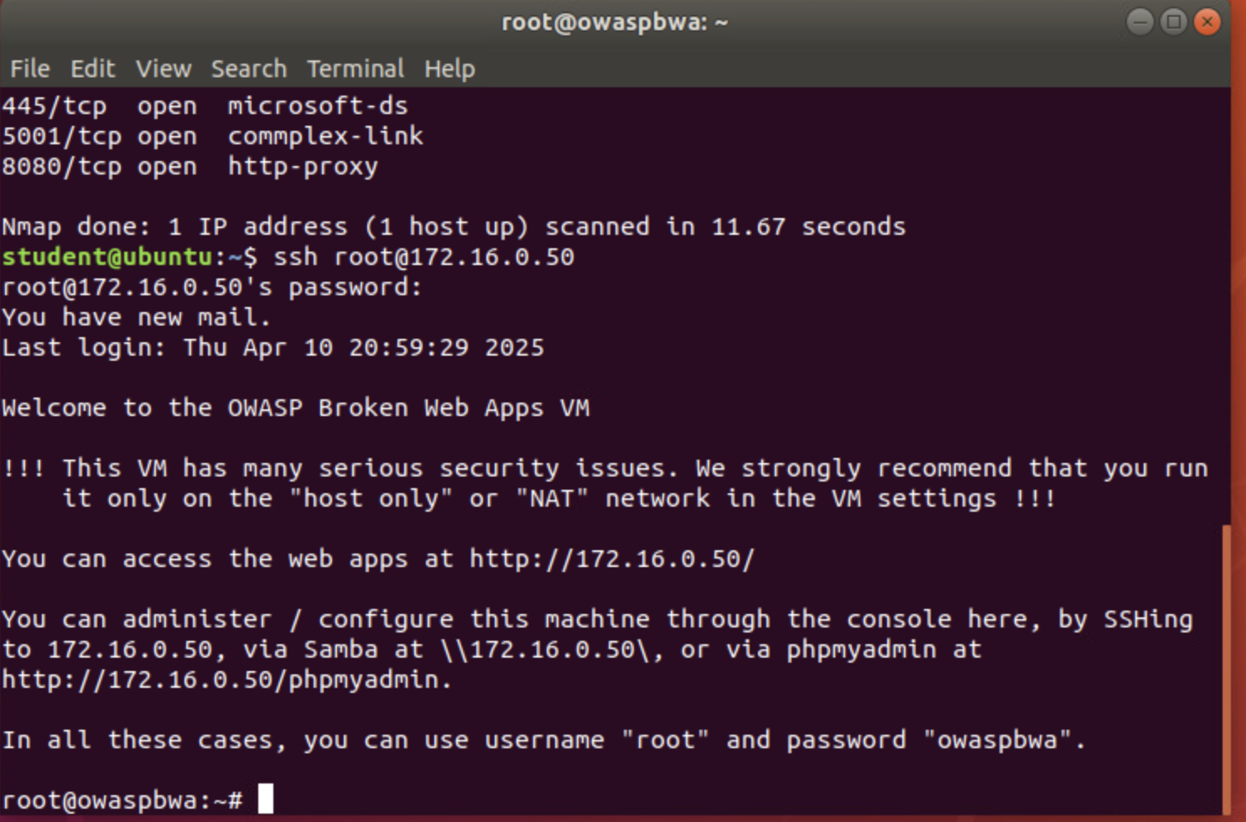
Time-based Access
Take a screenshot of the output in Part 1 Step 34.
It should show two time-based access rules in the FORWARD chain

Slide 28
Module 6 Project Video
https://hoop.dev/blog/unlocking-the-power-of-time-based-access-firewalls-for-modern-it-management/, Andrios Robert, December 6,2024
References

Slide 29
Project Challenges

Slide 30
There were few challenges encountered during the project process. Minor obstacles were primarily found while entering commands into the virtual machines used in the weekly modules.
When a command was typed incorrectly then the process would obviously not execute. These items
were easily and quickly corrected and the project continued.

Slide 31
Career Skills Learned

Slide 32
While working my way through SEC290, Fundamentals of Infrastructure Security, I learned several career skills which will build the foundation for my future in the world of cybersecurity.
The course focused on developing infrastructure security implementation skills. Topics included threat intelligence, identification of security vulnerabilities, cloud security, security data analysis, incidence response, risk management, and IT regulatory compliance. Valuable career skills I learned include, but are not limited to:
  configuring firewall rules,
  deploying Snort sensors for network intrusion detection,
  exploring SSL encryption,
  analyzing traffic to detect attacks,
  exploiting Microsoft vulnerabilities, and
  conducting live memory analysis.

Slide 33
Conclusion

Slide 34
As previously stated, this course project is a collection of all projects performed in virtual environments throughout this course. The virtual environments included several Linux-based systems as well as Microsoft.
This compilation illustrates the fundamentals of infrastructure security. While utilizing the virtual machine setting, activities were completed to learn how to manually conduct a vulnerability analysis, gain familiarity with Wireshark (intrusion analysis),
Creating and testing an SSL/TSL file (enables secure encrypted communication between a web server and a client--like a web browser), obtain experience with Snort (IDS/IPS) while testing and creating rules within the program, conducting live memory analysis.

